Slide 1
RAAP-2 Quantitatively linking physical and biological oceanographic data and developing models integrating these IMOS data streams.
By Iain Suthers, Peter Yates and Amandine Schaeffer
Monday 24 June 2019

Slide 2
The objectives of RAAP2 are to:
Couple oceanographic and animal tracking measurements to understand and predict animal movements (including key commercial species and apex predators) in NSW
Integrate IMOS physical and biological oceanographic data and the BPA/IMOS Marine Microbes project to resolve the oceanographic processes governing ecosystem and fisheries productivity in NSW
Develop machine-learning approaches for enhancing interpretation and uptake of IMOS data by researchers and key NSW stakeholders
Generally enhance the operations and integration of the NSW Node of IMOS

Slide 3
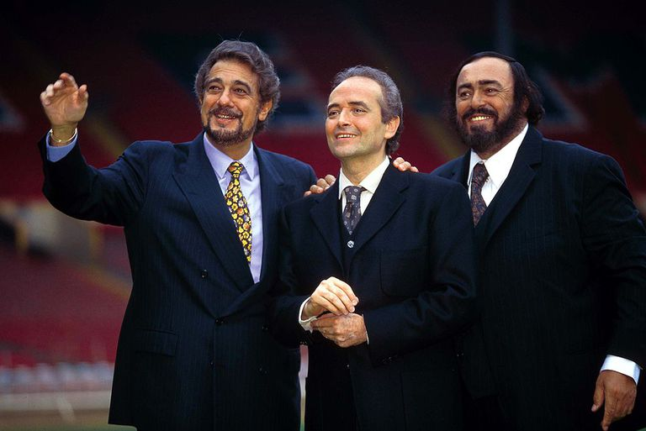
Ariel
Mike
Pete
Plus
Paloma Matis
IMOS larval fish monitoring
Maria Vozzo
SHRP
Ana Bugnot
Microbial diversity
Machine learning;
(mostly at Sydney U)
Inner shelf water

Slide 4
Key deliverables during the funding period include:
Creation of models for predicting the movement of key animals in NSW waters
Use the Coffs WERA radar, and Newcastle CODAR radar?
Therefore quantify “inner shelf water” – i.e. coastal oceanography
Identification of the oceanographic drivers of microbial productivity and the subsequent effects on NSW marine ecosystems
Improved delivery of monitoring data to facilitate rapid assessments

Slide 5
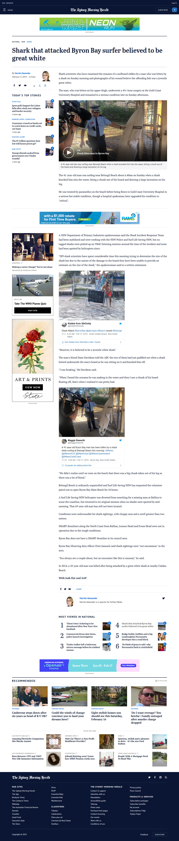


Slide 6
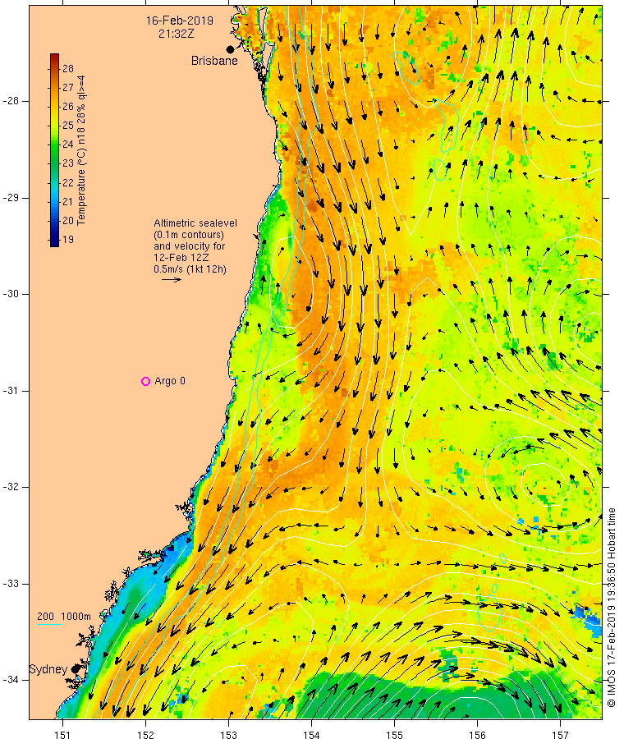
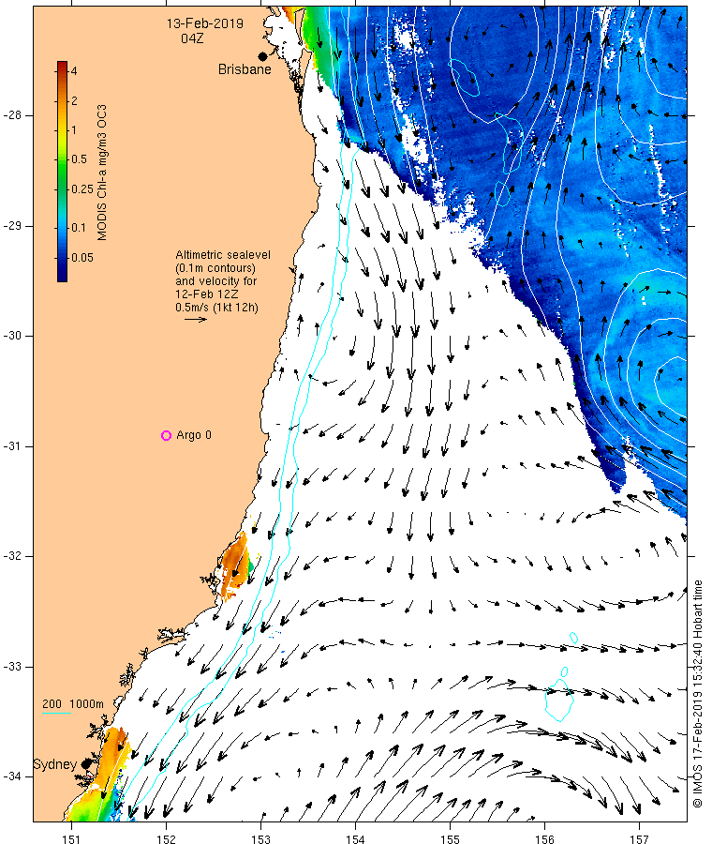
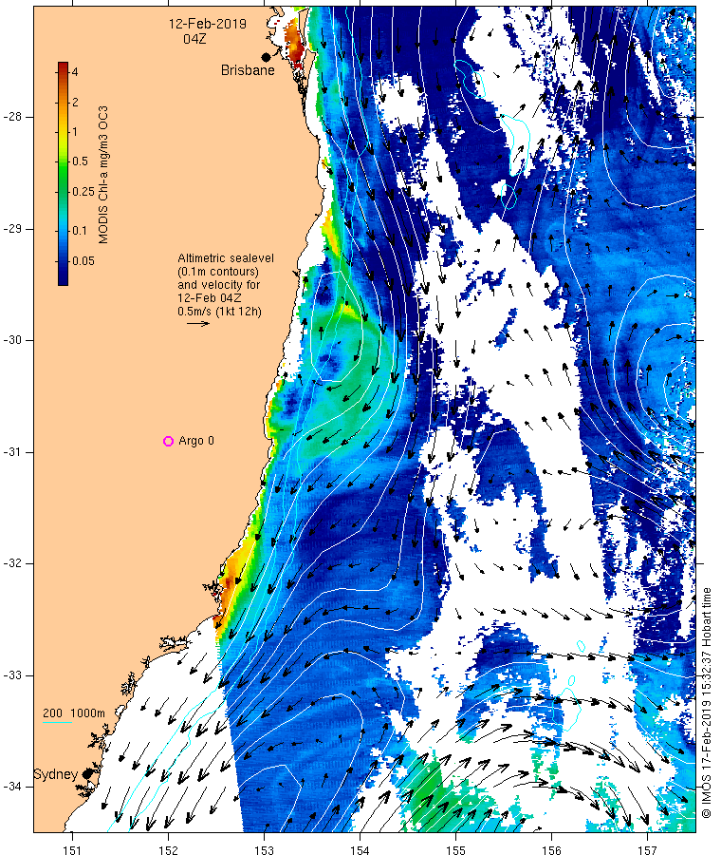

Slide 7
What we decided to do:
Write a review of Inner shelf water
“Coastal boundary layer”; temperate rocky reefs; Great Southern Reef etc
Marine Heat Waves?
Discontinued due to insufficient number of NRS zooplankton samples corresponding to heatwaves (at various depths and time windows).
Tiger sharks? – planned with Fabrice and Paul Butcher
To quantify and understand “inner-shelf” water
2004 Southern Surveyor voyage + any other cross-shelf transects
Relationships between microbes, zooplankton and larval fish
Effects of EAC etc on interannual fisheries production
DPI data agreement for prawn trawl CPUE – prawns, 2 whitings
Maybe RAAP-3?

Slide 8
What we can do now in 12 months
Write a review of Inner shelf water
“Coastal boundary layer”; temperate rocky reefs; Great Southern Reef etc
Marine Heat Waves?
Discontinued due to insufficient number of NRS zooplankton samples corresponding to heatwaves (at various depths and time windows).
Tiger sharks? – planned with Fabrice and Paul Butcher
To quantify and understand “inner-shelf” water
2004 Southern Surveyor voyage + any other cross-shelf transects (see next)
Integrated the vessel’s CTD data
Integrate moorings for broader perspective
Relationships between microbes, zooplankton and larval fish
Definitely do-able with Mike, Paloma and new-Pete
Effects of EAC, coastal wind etc on interannual fisheries production
DPI data agreement for prawn trawl CPUE – prawns, 2 whitings
Maybe RAAP-3?

Slide 9
Inner Shelf Water
Cross shelf transects
Range of Latitudes
Zooplankton/CTD data
Including size spectra

Slide 10
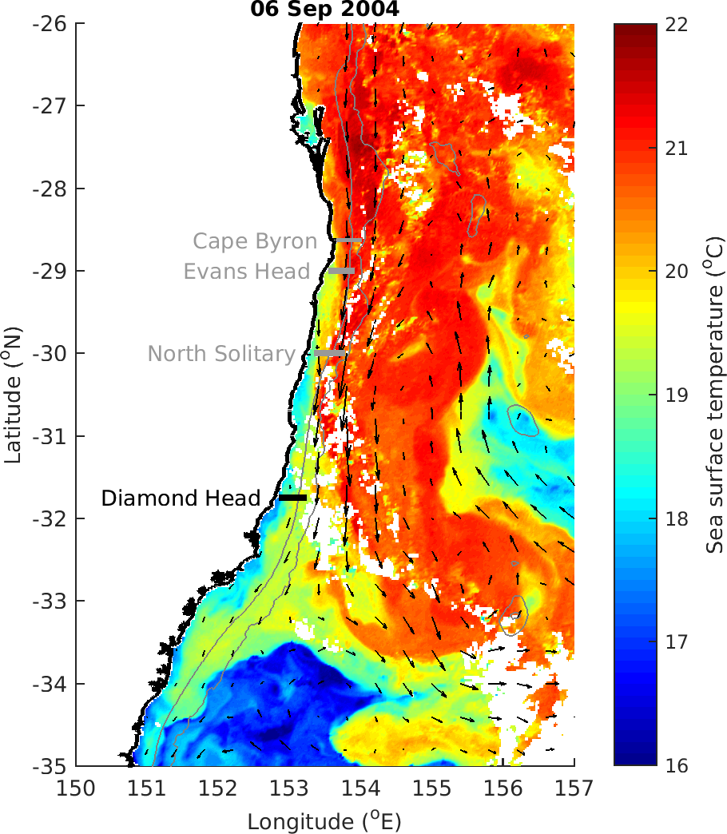

Slide 11
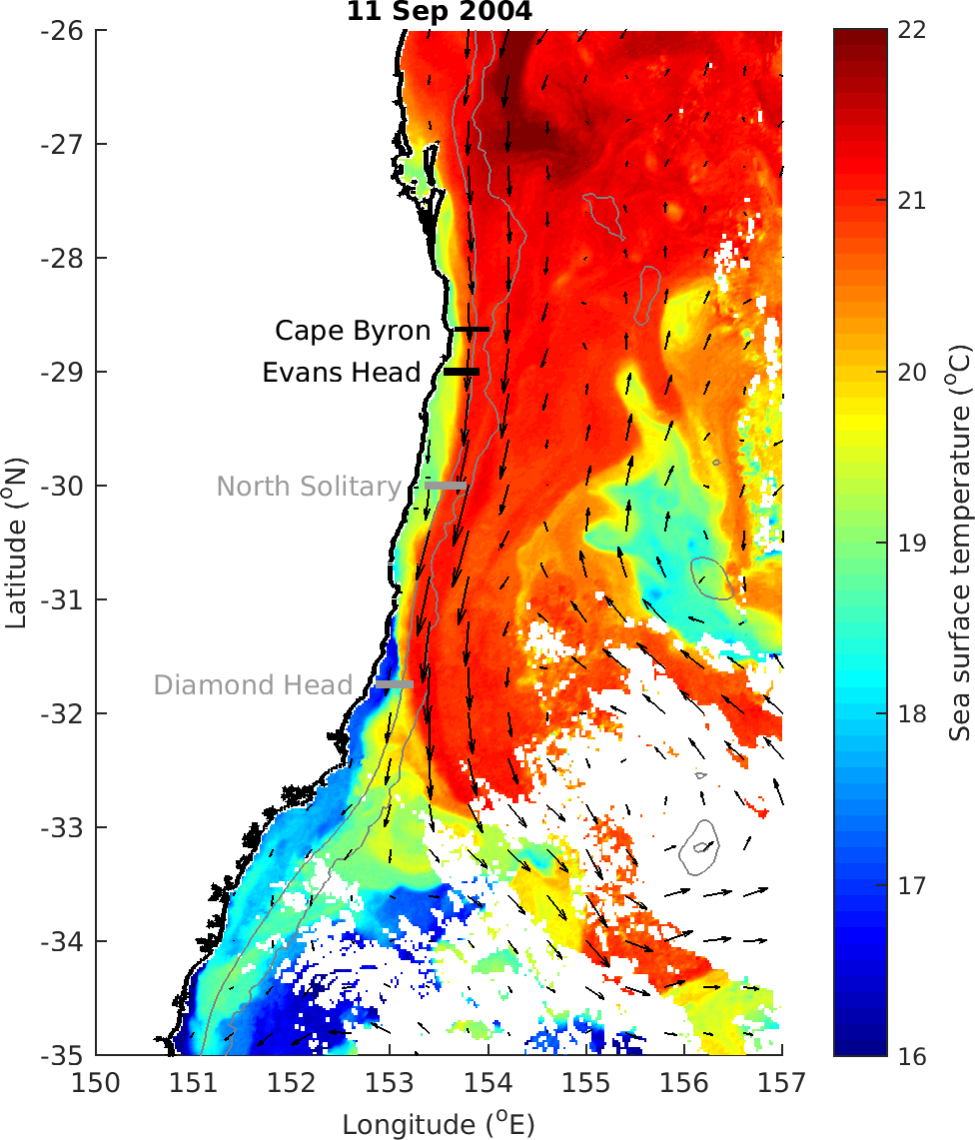

Slide 12
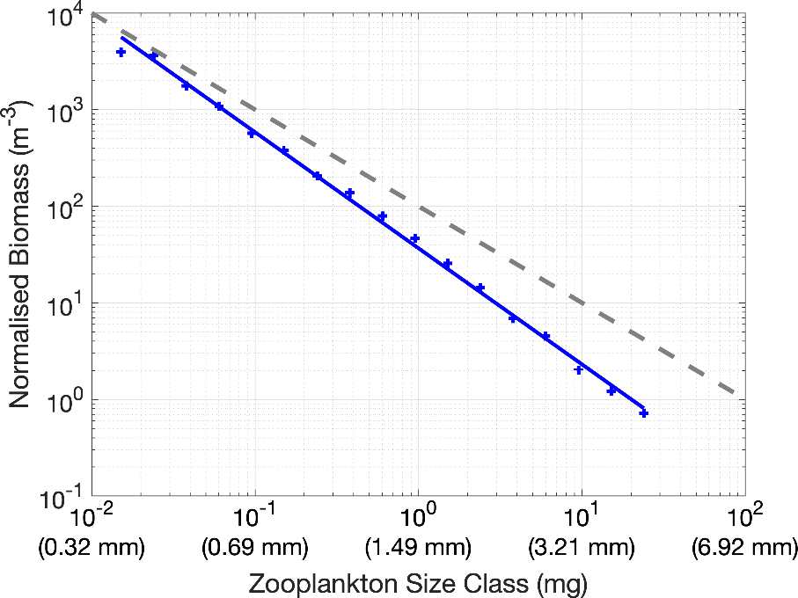
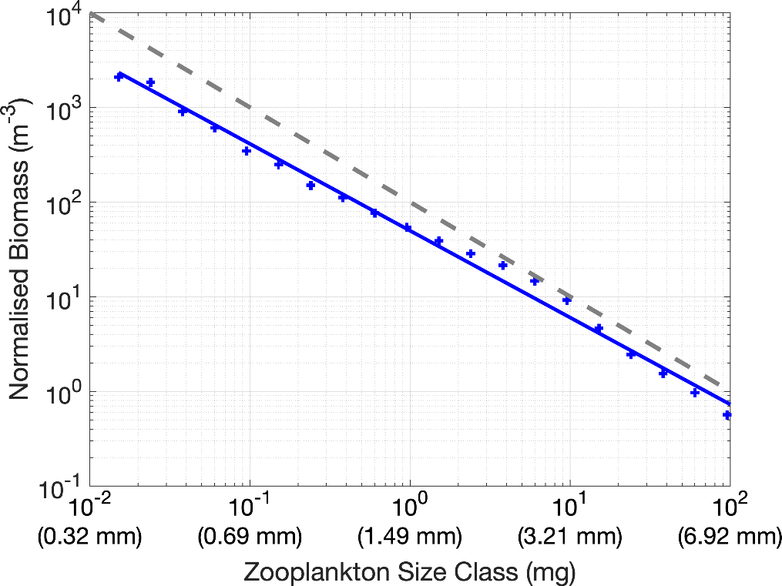
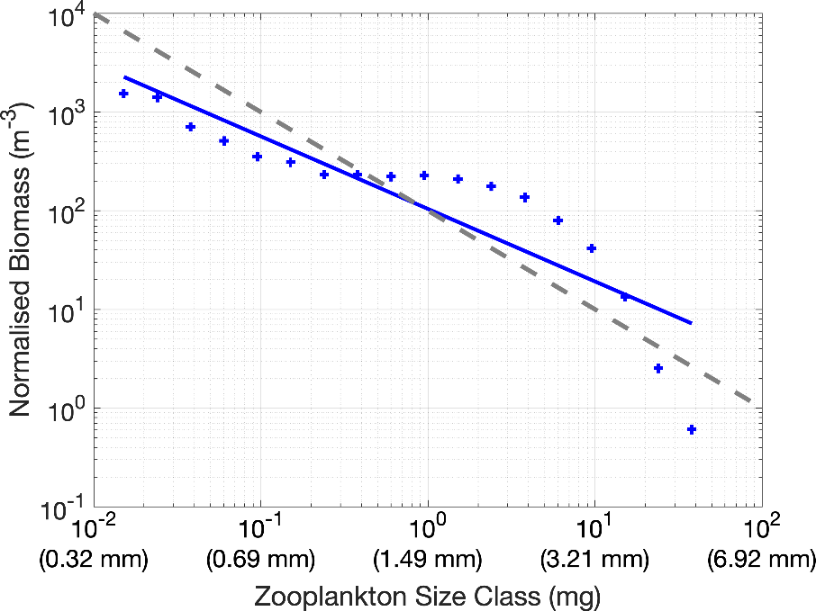
East Australian Current
Normalised zooplankton biomass size spectra;
From nauplii to krill;
Slope and intercept
Tasman Sea
Cyclonic Eddy

Slide 13
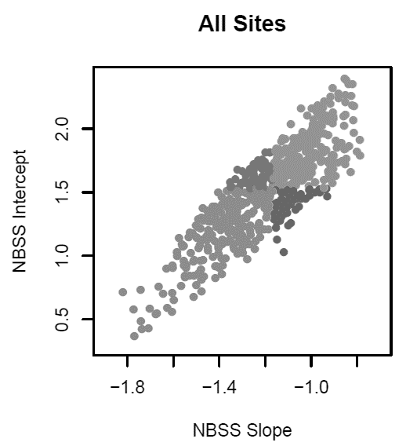
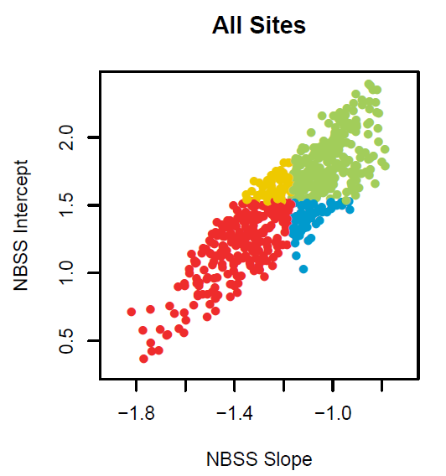
Zooplankton size spectrum; reveals the seascape of G (actually zoopl. prey) & M:
“intercept at x⁰ mg = 1 mg”
Median
steep slope, high food
shallow slope, high food ☺
Median
Log Normalised biomass
shallow slope, low food
Steep slope, low food ☹
Log size category (mg)

Slide 15
In conclusion, for next 15 months
We have someone in mind, starting 1st September
Concentrate on Inner shelf water;
Microbes-oceanography-larval fish interactions
Possible additional DPI funds 3-4 mo on larval crab transport in EAC+wind
The future?
Establish a platform for a mechanistic model of inner-shelf, inter-annual variation;
Inter-annual fisheries production for RAAP-3?

Slide 16
From Pete, 22 May
Below is my list of planned papers in rough order of work (with lots of overlap of course). I think this is a fairly ambitious list given there is little overlap in the workload between papers, but that’s the nature of this position I guess 😊. I feel this strikes a balance between my interests, Iain’s interests, RAAP, SIMS and IMOS. But I am keen to hear more about yours!
1) 2004 OPC
2) Relationships between zooplankton communities and microbe communities
3) Temporal and environmental drivers of tiger shark occurrence and residency along NSW. In collaboration with Paul Butcher at DPI and others. I’ve also been in contact with people doing similar research at MQ (Rob H’s lab) to check this isn’t overlapping with any of their work. I’d also like to include data on surface currents from the HF radar in a Coffs-specific model, although not focussing on frontal eddies, as we’ve emailed about before.
4) Environmental drivers of commercial catch rates of prawns and whiting. Effect of EAC on fisheries productivity. Still waiting for data.
5) Particle tracking for blue swimmer crabs and mud crabs. There is some separate funding for this from DPI. To be honest I’m not passionate about this one. Its been on/off our list a few times. Happy to keep it on the list for later.
At this stage I’ve decided not to continue with the ISW review paper although I’m sure all of that reading and indexing I did will be very helpful for all of the above.

Slide 17
15 May19 meeting with Pete
Me, jase, amandine in Roundtree room

Slide 18
Data exploration
Outliers in x and y and x~y
Relationships between x variables
Relationships between x and y variables
Interactions - are any apparent and is there enough data to test for them?
Independence
Homogeneity and balance across factor levels and two-way factor-level combinations
Occurrence of zeros and NAs

Slide 19
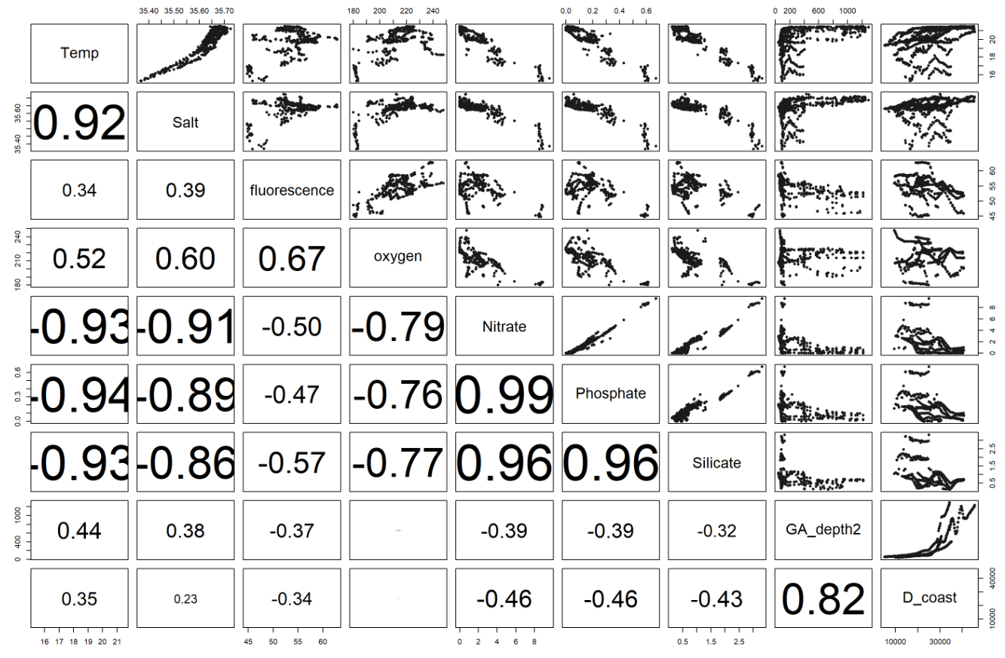

Slide 20
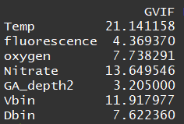
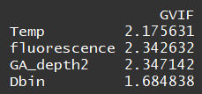
Variance inflation factors
i.e. is a measure for how easily an x-variable is predicted from a linear regression using the other x-variables.
Should be <3
Removing oxygen, Vbin, nitrate

Slide 21
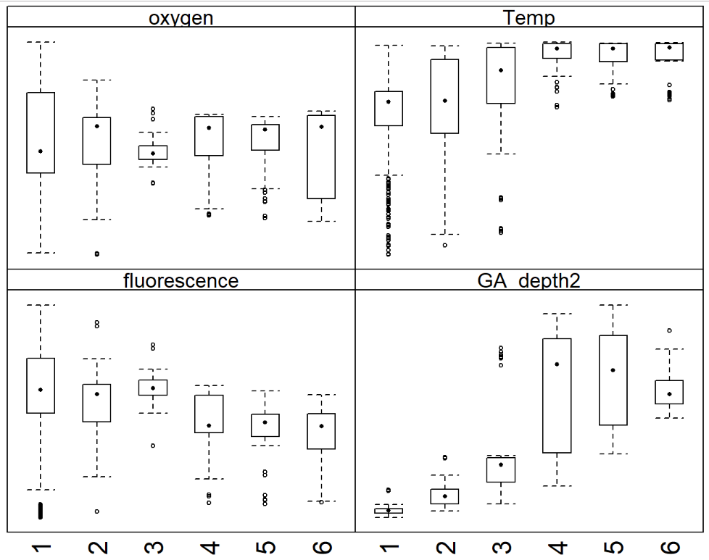
Remove seafloor slope
Seafloor slope

Slide 22
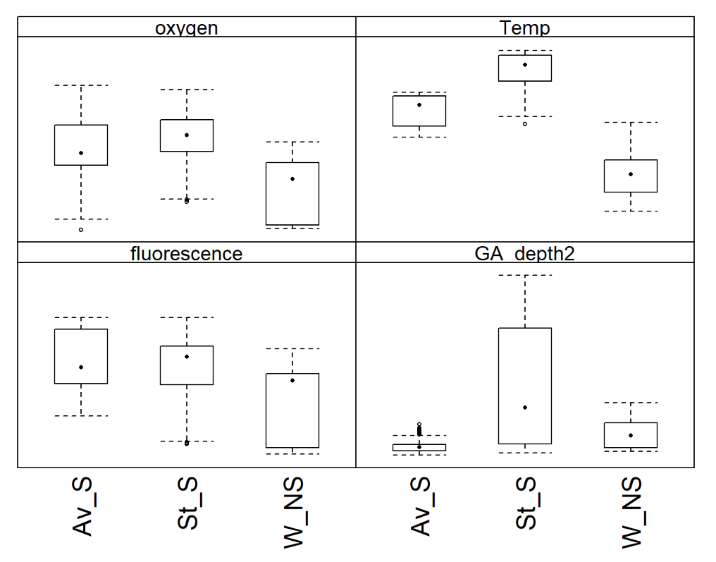
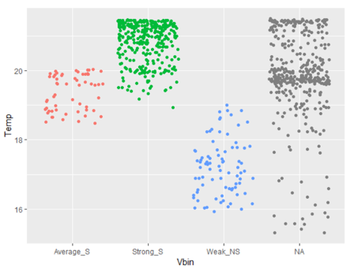
Remove Vbin (more reason to, plus the NAs)
and removal influences temperature effect…

Slide 23
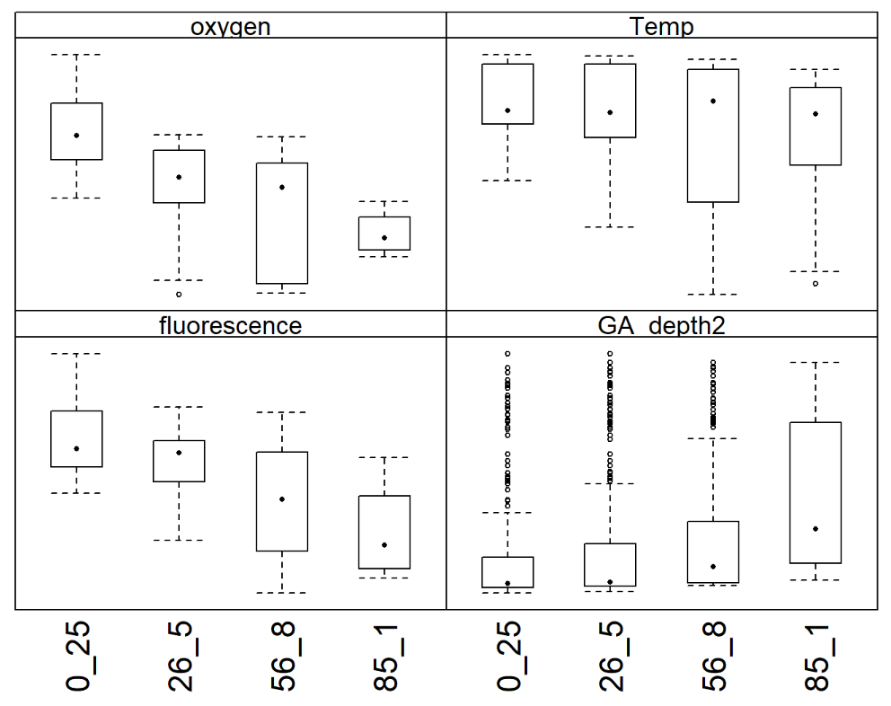
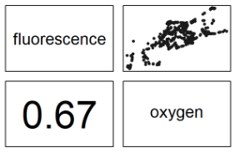
Removing oxygen (more indication)

Slide 24
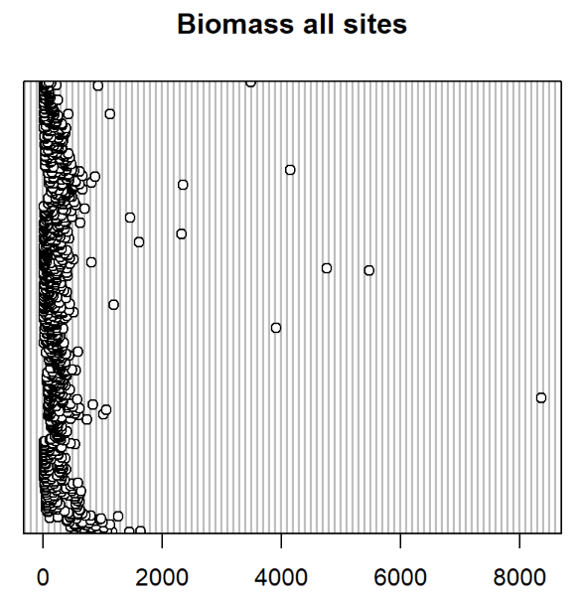
Outliers in y

Slide 25
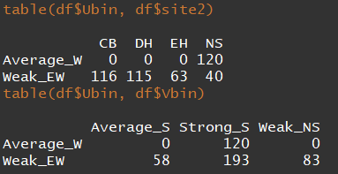
Balance across factor levels
All levels do have enough observations (10-15). Hence they are balanced in one dimension.
However, there are some issues here in the two-way combos:
Ubin is entirely determinable by site
Ubin can be determined based on Vbin and vice versa.

Slide 26
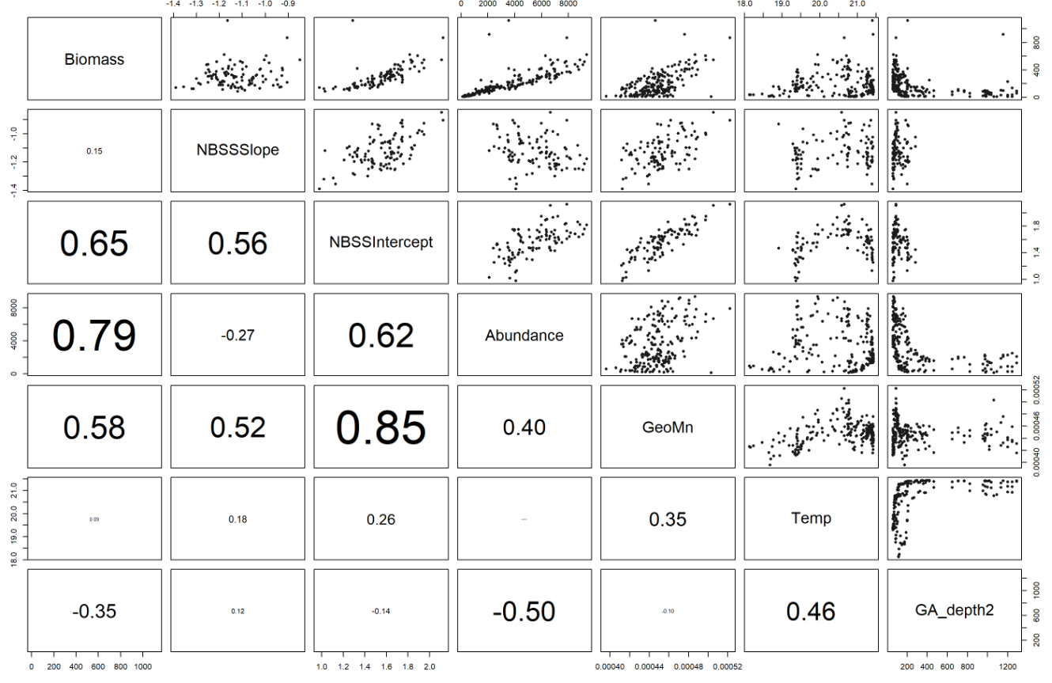
Relationships with y variables @ CB

Slide 27
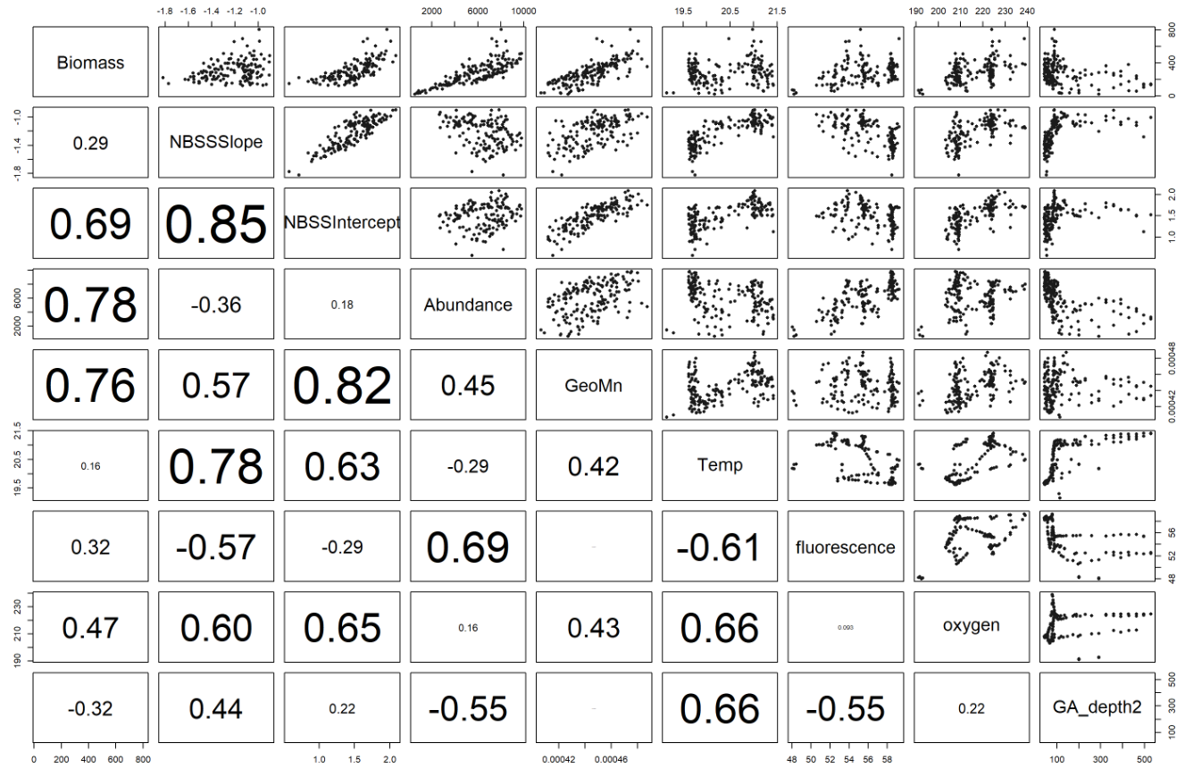
Relationships with y variables @ EH

Slide 28
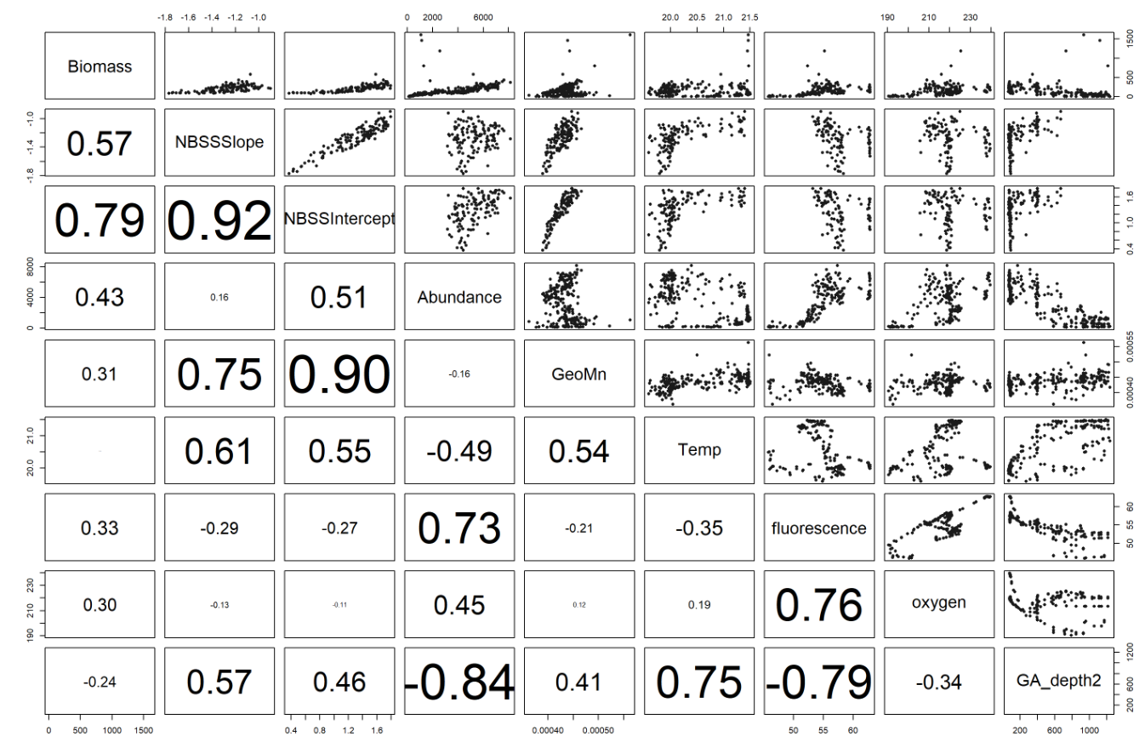
Relationships with y variables @ NS

Slide 29
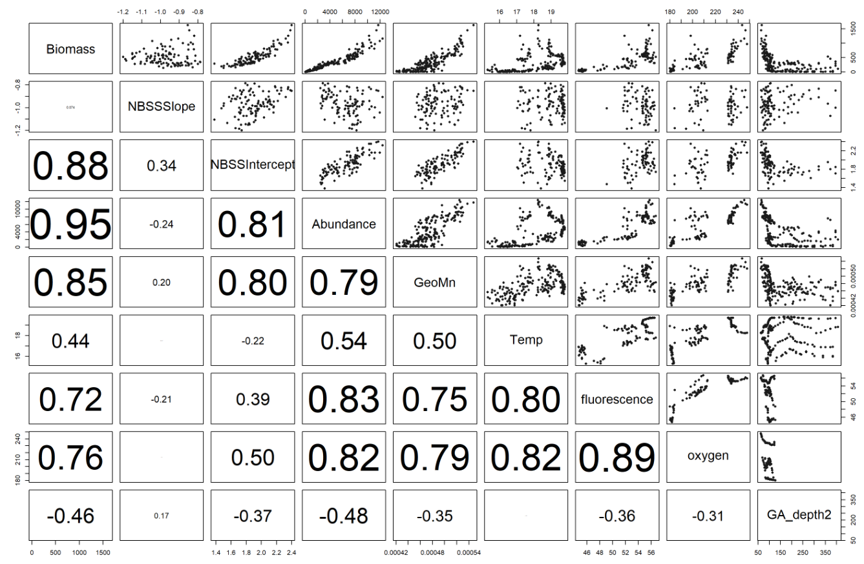
Relationships with y variables @ DH

Slide 30
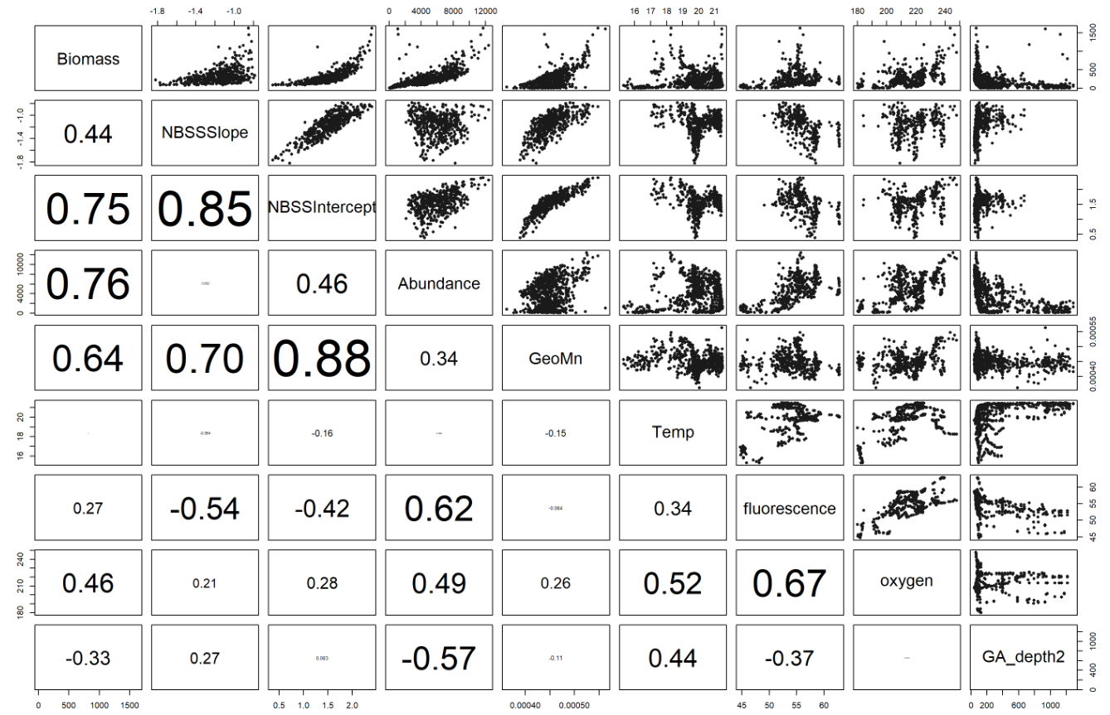
Relationships with y variables @ all sites

Slide 31
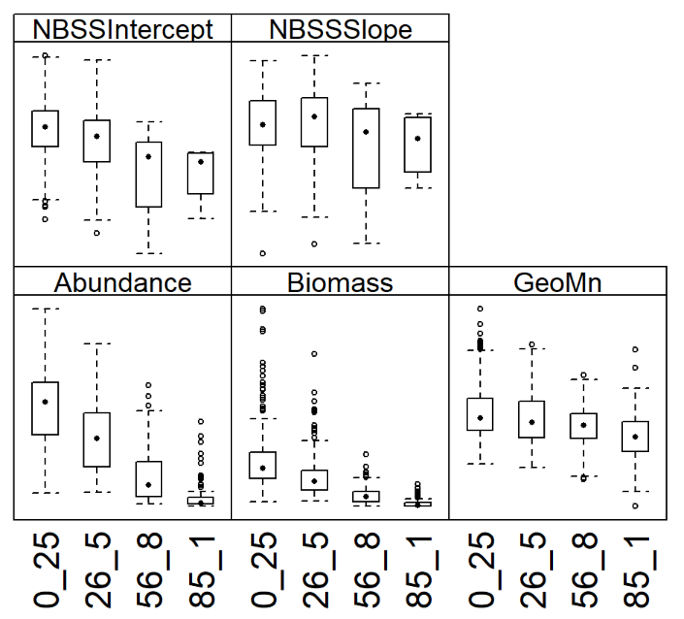
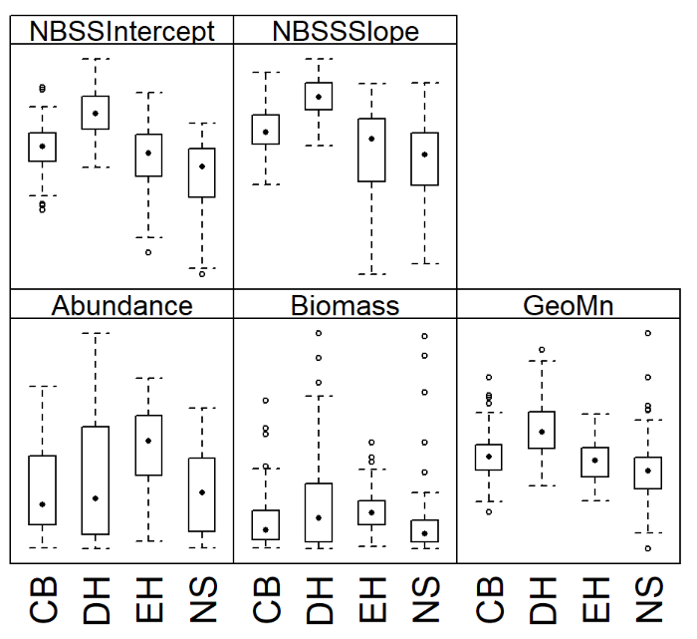
Categorical x versus y
Depth Bin
Site

Slide 32
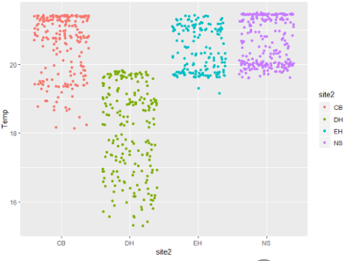
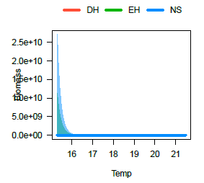
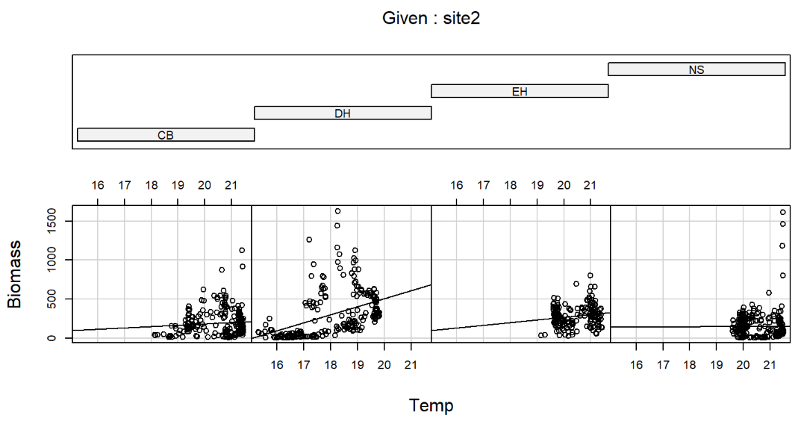
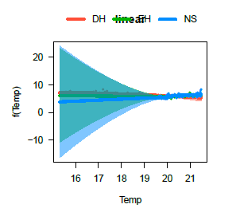
Interactions
Temp
site

Slide 33
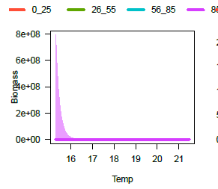
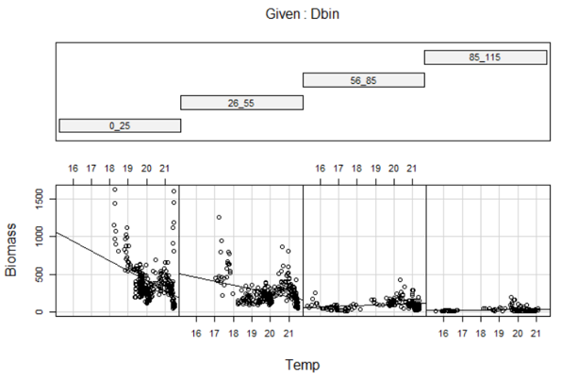
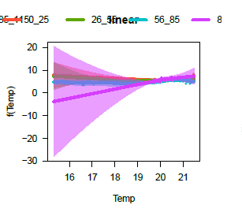
Interactions

Slide 34
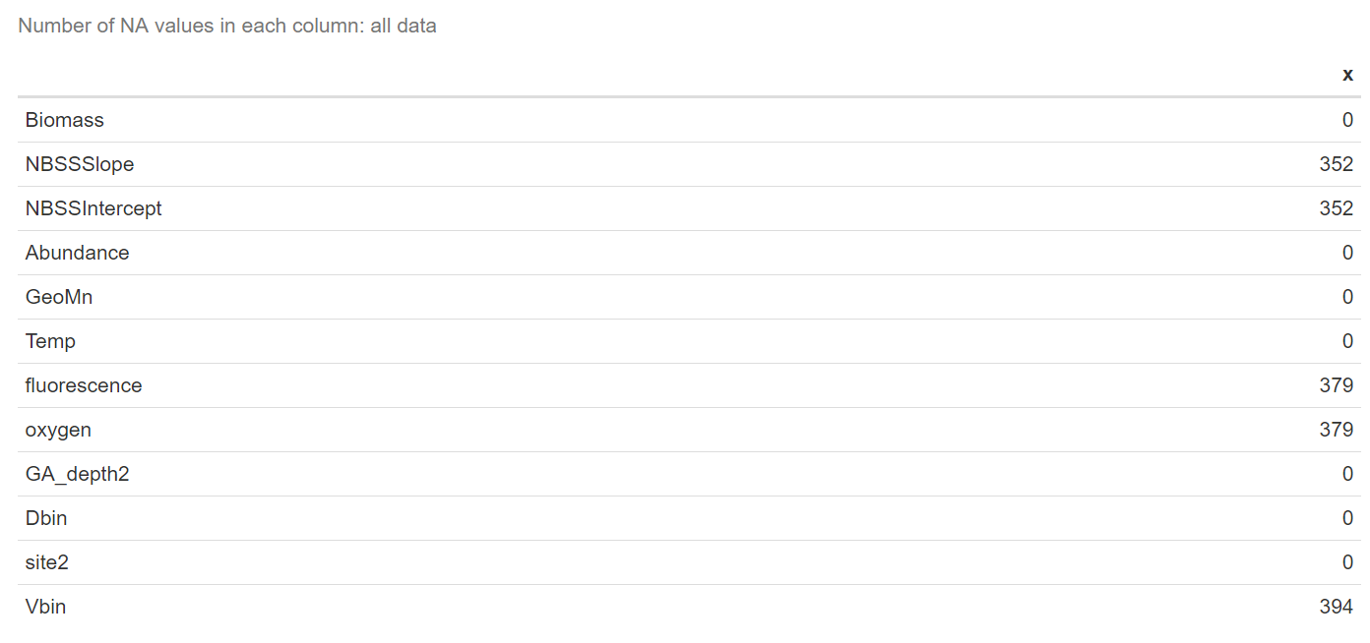
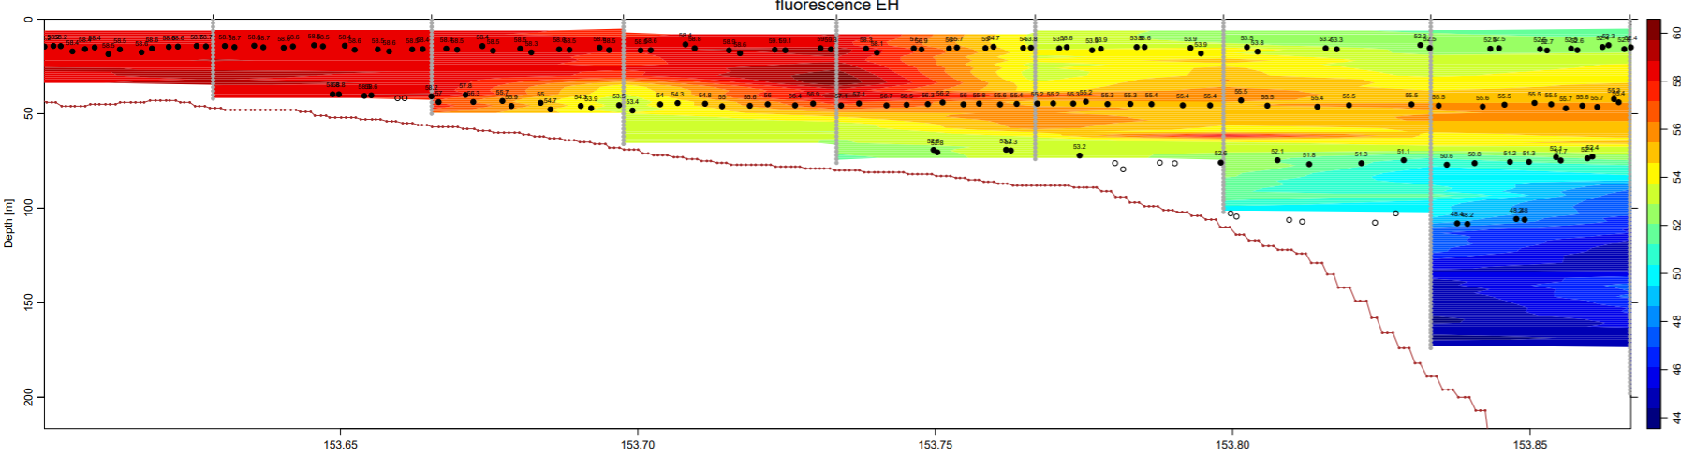
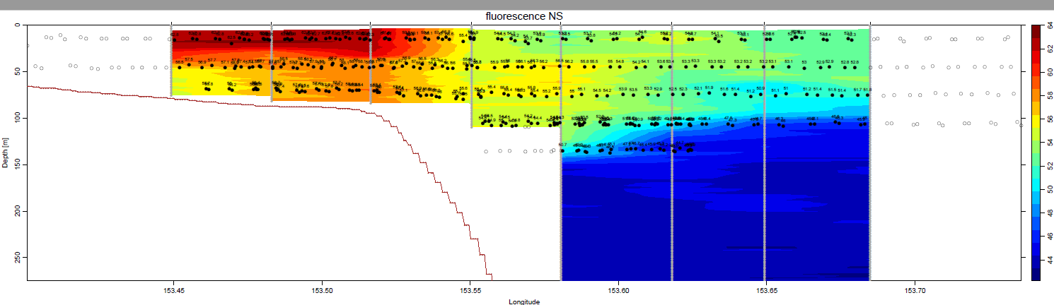
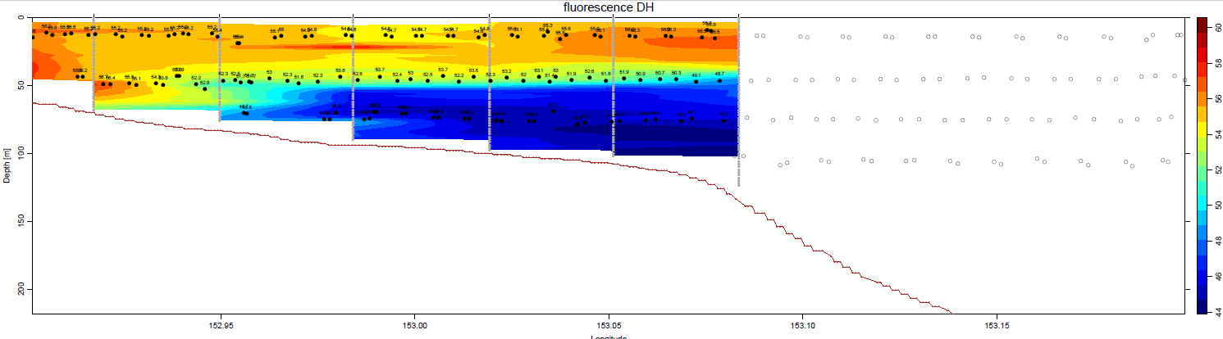

Slide 35
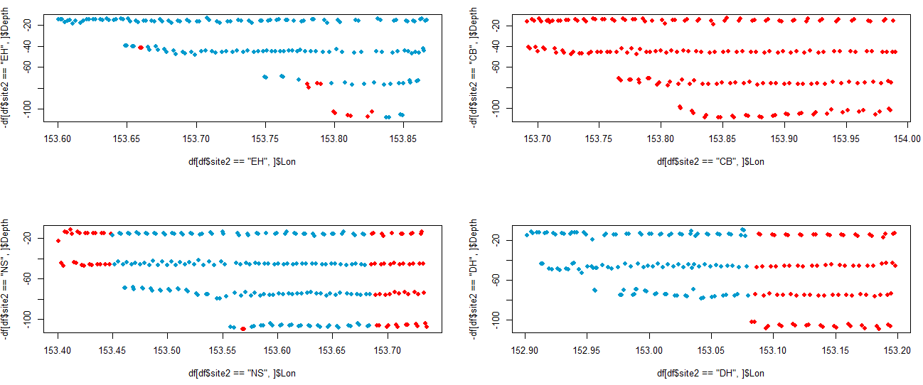
NAs in fluorescence

Slide 36
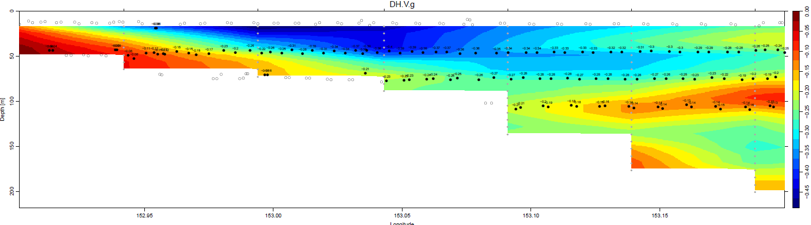
NAs in Vbin

Slide 37
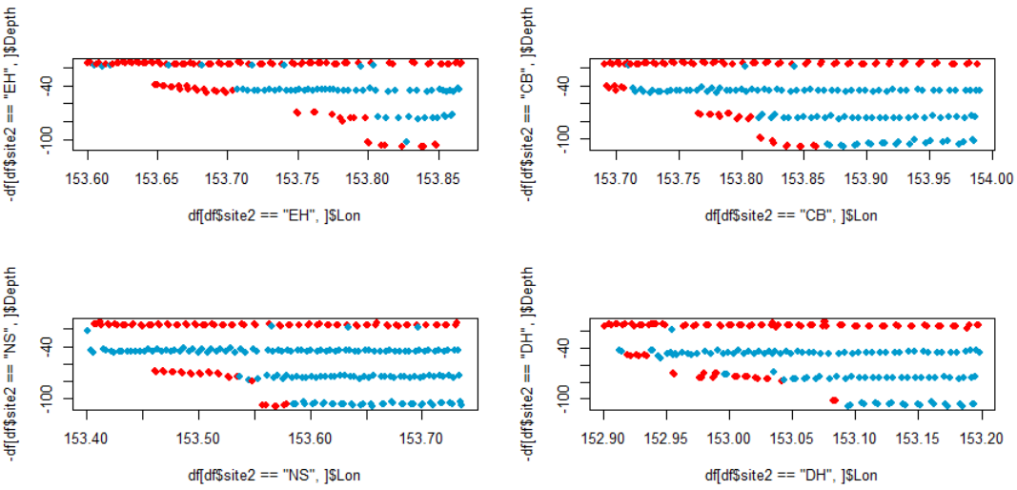
NAs in Vbin

Slide 38
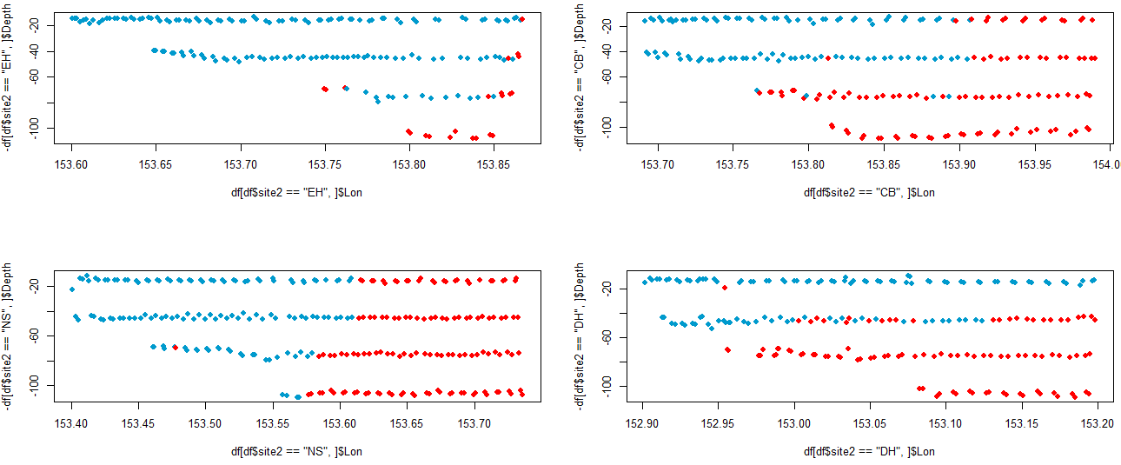
NAs in NBSS slope

Slide 39
Approach
No interactions (?)
Want to keep as much data as possible, although this precludes use of AIC
Present full models (i.e. no model selection)
“the authors of this book prefer to present the full model without prior model selection. The crucial condition is that there be no collinearity. This is most practical for models with fewer than 10 covariates
….this means that we present a model in which some of the covariates may be non-significant” (Zuur et al 2012).
Reminder of what’s left:
Temperature
Fluorescence – has na’s
Bathymetry
Sample depth bin
site
Transect sample depth bin ~ longitude ~ site in spatial correlation term

Slide 40
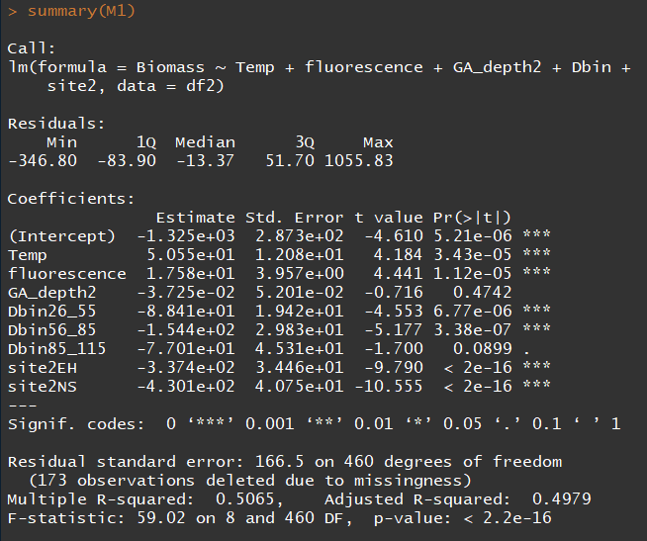
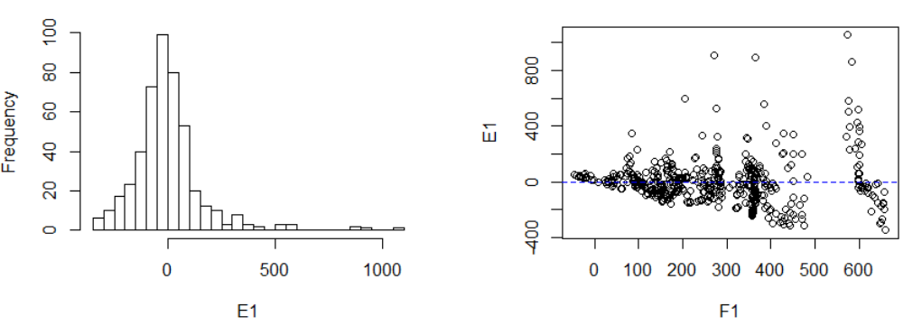
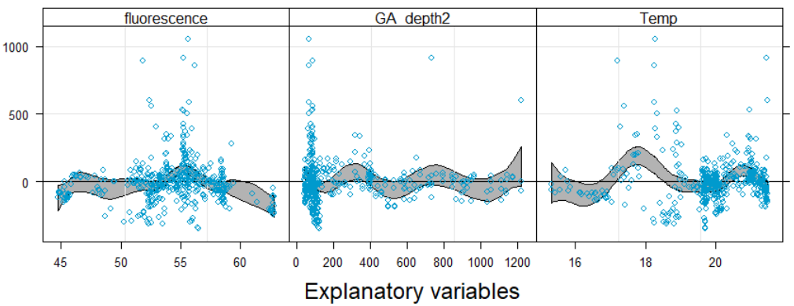
Step1: linear models (biomass example)
M1<- lm(Biomass~Temp+fluorescence+GA_depth2+Dbin+site2, data=df2)
Non-normality, heteroscedasticity, negatived fitted values, non-linear residual patterns

Slide 41
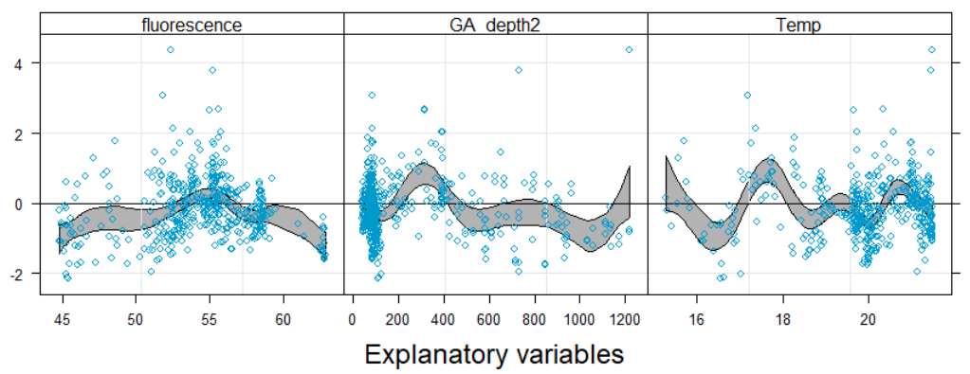
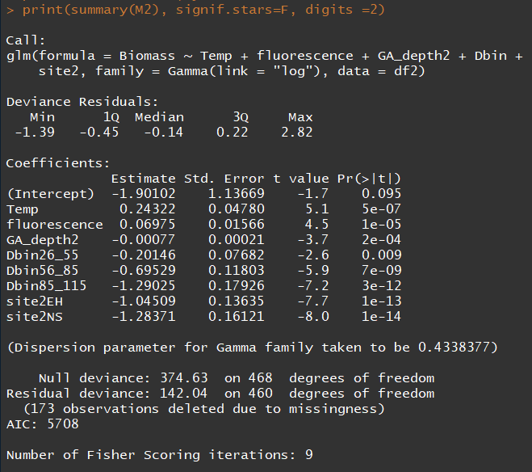
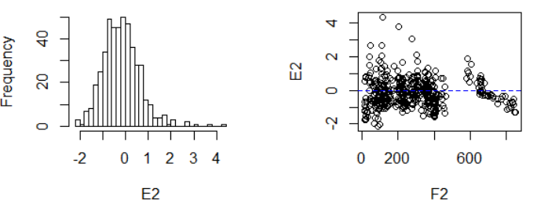
Step2: move to GLM
Gamma distribution for biomass and abundance
Gaussian distribution for NBSS slope and intercept
M2<- glm(Biomass~Temp+fluorescence+GA_depth2+Dbin+site2, data=df2,family=Gamma(link="log"))

Slide 42

M2 continued

Slide 43


Step 3: try cubic polynomial terms
M3 <- glm(Biomass~poly(Temp,3)+poly(fluorescence,3)+poly(GA_depth2,3)+Dbin+site2, data=df3,family=Gamma(link="log"))

Slide 44




M2 <- gam(Biomass ~ s(Temp) + s(fluorescence) + s(GA_depth2) + site2 + Dbin, data=df3,family=Gamma(link="log"), method="REML")

Slide 45

Something is wrong ☺

Slide 46



Spatial autocorrelation

Slide 47




Including a spatial autocorrelation term (working?)
M3 <- gamm(Biomass ~ s(Temp) + s(fluorescence) + s(GA_depth2) + site2 + Dbin, data=df3,family=Gamma(link="log"), method="REML", correlation = corGaus(form = ~ Dbin+Lon| site2))

Slide 48


Gamm with spatial autocorrelation term
Gam without spatial autocorrelation term

Slide 49

Temperature….(over fitted?)
Mgcv does cv for automatic selection of amount of smoothing (df).
Df ~ 1 = straight line, df~10 non-linear.
Explanation of CV on age 49 of Zuur 2012.
Alternatively we can specify different values of k (=df+1)

Slide 50






Is the effect of temperature being hijacked by other variables in the model? (undetected collinearity?)

